Slide 1
Freedom of Assembly, Crowd Management & the Rule of Law
Prof. dr. em. Paul Ponsaers (Ghent University, Belgium)

Slide 2
Assignment
To be able to reflect on Turkish police performance in regard to freedom of association, freedom of speech and privacy (regarding digital surveillance) in relation to the EU norms stipulated in the ‘EU Convention of Human Rights’.
To be able to define freedom of assiociation and irregular digital surveillance more concretely
To be able to formulate recommendations for training within the police academy regarding compliance to EU norms on this two subjects. How can discretion be important in police performance when it comes to freedom of association?

Slide 3
Content
Rule of Law
The Four Universal Principles of the Rule of Law
Police discretion
Use of Force
Human Rights
Spontaneaous and organized events
Treath analysis and crowd assessment
Negotiated Management of Public Space
Surveillance and Human Rights
What is surveillance?
What are rights?
What are problems

Slide 4
1. Rule of Law
The Four Universal Principles of the Rule of Law
Accountability: The government as well as private actors are accountable under the law.
Just Law: The law is clear, publicized, and stable and is applied evenly. It ensures human rights as well as contract and property rights.
Open Government: The processes by which the law is adopted, administered, adjudicated, and enforced are accessible, fair, and efficient.
Accessible and Impartial Justice: Justice is delivered timely by competent, ethical, and independent representatives and neutrals who are accessible, have adequate resources, and reflect the makeup of the communities they serve.

Slide 5
1. Rule of Law
An effective police service carry out its work in a way that does not rely on fear and raw power, but instead on regard for the law and professionalism.
Public confidence is built and community cooperation fostered;
Legal prosecutions are successful in court;
Police are seen as part of the community, performing a valuable social function;
The fair administration of justice and hence confidence in the system is served;
An example is set for respect for the law by others in society;
Police are able to be closer to the community and therefore in a position to prevent and solve crimes through proactive policing;
Support is elicited from the media, from the international community and from higher authorities; and
A contribution is made to the peaceful resolution of conflicts and complaints.

Slide 6
1. Rule of Law
Police Discretion
the freedom of judgment and choices given to police officers in specified circumstances in accordance with their governing policies. The power to act in an official capacity in a manner which appears just and proper under the circumstances - in this action the officer takes in correspondence to personal judgment, conscience, morals, attitude, and/or beliefs as well as the officer’s training, experience, and education
Due to police discretion, police officers have a range of choices to make when faced with certain situations. This means that different officers may make different choices even if they are all faced with the same situation. Police discretion is most often used in the field, and officers base their choices on the surrounding circumstances and factors, such as officer safety, that need to be taken into consideration.
Because every officer is different, with different attitudes and backgrounds, there is no absolute right choice and officers have flexibility in dealing with the situations they encounter.
For example, when anyone commits a minor offence, officers have the discretion to let that person go after a warning or to charge that person and bring him/her to jail.

Slide 7
Content
Rule of Law
The Four Universal Principles of the Rule of Law
Police discretion
Use of Force
Human Rights
Spontaneaous and organized events
Treath analysis and crowd assessment
Negotiated Management of Public Space
Surveillance and Human Rights
What is surveillance?
What are rights?
What are problems

Slide 8
2. Use of force
Use of force should be
legal (police competences should be described in a detailed way by law),
necessary (exhaust all other means that are available) and
proportional (the degree of force used is proportionate to the immediate risk faced by the officer and/or the public).
Officers try to de-escalate confrontations by maintaining distance, using calming communication techniques, and exhaust all other means of response before resorting to force.
Policies should also establish comprehensive reporting, investigation, and oversight systems of officer-involved shootings, other use-of-force incidents, in-custody deaths, and police-caused injuries to ensure that all incidents are promptly independently investigated. Law enforcement agencies can direct officers to intervene when other officers use force that is not objectively proportional, and to report all incidents of force.​​​​​​
This implies specialized training for police-officers to reduce unnecessary force and install principles and practices of procedural justice and fairness. Also in relation to youth and mental health problems. Police can limit the use of unnecessary force as part of a comprehensive agenda for community-centered policing.
Departments should also consider early intervention procedures designed to correct and train officers who use excessive force.

Slide 9
Content
Rule of Law
The Four Universal Principles of the Rule of Law
Police discretion
Use of Force
Human Rights
Spontaneaous and organized events
Treath analysis and crowd assessment
Negotiated Management of Public Space
Surveillance and Human Rights
What is surveillance?
What are rights?
What are problems

Slide 10
3. European Convention on Human Rights Freedom of Association
Art. 11
Everyone has the right to freedom of peaceful assembly and to freedom of association, including the right to form and join trade unions with others for the protection of his interests.
The exercise of these rights shall be subject to no restrictions other than those provided for by law and which are necessary in a democratic society in the interests of national security, public safety, the prevention of disorder and criminal offences, for the protection of health or morals or the protection of the rights and freedoms of others. This Article does not prohibit lawful restrictions on the exercise of these rights by members of the armed forces,
“peacekeeping”

Slide 11
3. European Convention on Human Rights Freedom of Association
“Negotiated management of public space”
SPONTANEOUS PROTESTS/DEMONSTRATIONS (not planned)
Usually develops informally and is mostly done by word of mouth (one person to another or one group to another).
Participants spread information by telling one another when, where, and what …. Spreading information via electronic means text messages or social media.
ORGANIZED EVENTS (planned)
An organized assembly involves individuals and groups passing on information to one another in preparation for a long-term event, some group organizers have the means to provide logistical support, such as transportation, food, and water for the participants.
Rarely is only one group responsible for pulling together a gathering. Organized assemblies rely heavily on established groups that attract people to gather.
Examples of well-organized assemblies are groups representing religious faiths, ethnic organizations and labour unions. Organized-gathering processes rely more on centralized planning and organization. One or more groups offer the organizers numbers of participants and groups from which they contact as potential participants.

Slide 12
Content
Rule of Law
The Four Universal Principles of the Rule of Law
Police discretion
Use of Force
Human Rights
Spontaneaous and organized events
Treath analysis and crowd assessment
Negotiated Management of Public Space
Surveillance and Human Rights
What is surveillance?
What are rights?
What are problems

Slide 13
4. Negotiated Management of Public Space
Negotiated Management of Public Space is based on the Elaborated Social Identity Model (ESIM). It is a social psychological explanation of crowd behaviour that incorporates group interactions, e.g. the police versus the crowd.
According to the model, the responsibility for violence must be shared between the gathered crowd and the control force. It states that the actions and reactions of the Crowd Control Unit play a significant part in the levels of violence that occur and places the blame on law enforcement. For this reason members of the intervening police unit must be fully aware of their actions, reactions, and behaviors and how they affect the gathered crowd and its participants’ actions and behaviors.
ESIM describes crowd behaviour based on the way people perceive themselves as group members, in terms of their social identity and self-categorisation. These concepts explain how a person that feels like a football supporter, will act as a football supporter.
The escalation of tension and the potential for violence begins when one side or the other violates the rules. Through the violation of the implicit rules, one crowd or the other triggers entry of both into an ever-escalating cycle of action, reaction, and counteraction.

Slide 14
4. Negotiated Management of Public Space
Is the event planned/organized? Is it spontaneous?
Is there an advice rendered by the police based on threat assessment to the competent authority?
Are the organizers known?
Is the event authorized by the competent authority?
Are there rules negotiated with the organizers concerning:
the trajectory,
the duration,
the public order maintenance of the organizers,
what will not be accepted, etc.
Was there a negotiation on tolerance rules?
Are they communicated within the intervention unit?

Slide 15
4. Negotiated Management of Public Space
Threat analysis and crowd assessment
Who are they and what is the overarching identity of the crowd?
What are their goals?
What is the composition of the crowd and are thare any known factions?
What are they capable of doing?
What are their traditional behaviours or cultural repertoires?
When and where will they assemble?
Where will they go?
What are the possible targets of violence?
When and where will they disperse?
Are there plans for subsequent gatherings?
What is the worst-case scenario?

Slide 16
4. Negotiated Management of Public Space
Gathering and analyzing information about an event is crucial to increase the effectiveness of crowd control planning and response to incidents involving crowd management. When estimating the impact of an anticipated event, it is central consider the need to:
Protect the rights of persons to lawfully assemble and express their opinions
Maintain a peaceful situation
Deploy officers to acquire information and eventually to acquire evidences
Event-related activities should be facilitated
Assist local authorities in providing a public safety response
Address unlawful conduct - either past, present, or anticipated

Slide 17
4. Negotiated Management of Public Space
The dispersal phase ends the gathering process or begins its deterioration. It involves the movement of people from the initial location where they assembled to one or more alternate locations. Dispersal can occur on a routine, emergency, or coerced basis.
Routine: is when the crowd leaves on its own with no outside influence - maybe specified in advance and can be included in the assembly instructions given by the organizers of the event.
Emergency: when people abandon an area as a result of an unexpected crisis (fire, explosion, bomb threat, terrorist act). Individuals in such an emergency quickly recover from the initial shock and often find improvised ways of extricating themselves and their companions from the dangerous situation. Therefore, it is critical that Police on the scene follows carefully the situation not to confuse group dispersal from a violent act.
Coercion: Coercion dispersal is characterized by use of force . Therefore as to be considered as the last resort. Consequently commanders on the spot should carefully consider the negotiation option. This in fact is the preferred method to be adopted and has proven to be highly successful in creating the right conditions to anticipate the potential for incidents

Slide 18
Content
Rule of Law
The Four Universal Principles of the Rule of Law
Police discretion
Use of Force
Human Rights
Spontaneaous and organized events
Treath analysis and crowd assessment
Negotiated Management of Public Space
Surveillance and Human Rights
What is surveillance?
What are rights?
What are problems

Slide 19
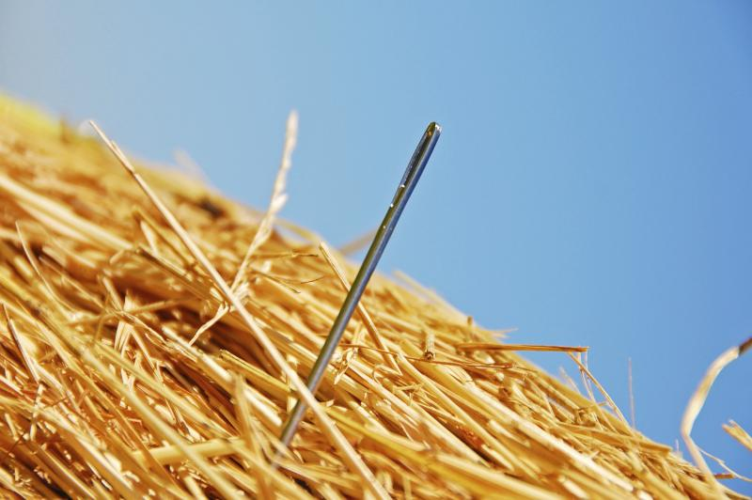
5. Surveillance and Human Rights
What is surveillance?
Some States develop targeted surveillance tools within their own agencies and departments
Others use existing “off the shelf” crimeware products
Others purchase sophisticated commercial spyware on the international surveillance market
From CCTV and “in-house tools” to mass technology and digital surveillance
Difference between
mass surveillance: bulk interception, collection and retention of private data
targeted surveillance: enables an actor to gain surreptitious access to the digital communications, work product, browsing data, research, location history and online and offline activities of (targeted) individuals (ex. Terrorists, activists, journalists)
Danger?
Private industry has stepped in, unsupervised and with something close to impunity.
More than 500 companies are developing, marketing and selling digital surveillance to government purchasers (Privacy International, 2016 )

Slide 20
5. Surveillance and Human Rights
Types of surveillance technologies used by governments to monitor individuals or groups
Computer interference
Infection of the computer with an intrusive form of malware, e.g. FinSpy. It records individuals and their family’s Internet video calls, emails and other communications, including by logging keyboard strokes, sending the data back to the government.
Mobile device hacking
Private surveillance products offer the capability of hacking directly into mobile devices. The NSO Group’s Pegasus spyware is a paradigmatic example and its alleged use in Mexico is instructive.
Social engineering
Many of the technologies described above are accompanied by strategies to lure a target without knowing downloading malware on their devices.
Ex. A WhatsApp message linked by researchers to spyware was sent to an CSO staff member urging him to cover a protest, including a link that it claimed would lead to additional information. Clicking on the link would likely have downloaded the spyware on his device.

Slide 21
5. Surveillance and Human Rights
Network surveillance
Some technologies work on a network to enable targeted surveillance.
Ex. Some systems for Operative Investigative Activities involve the installation of a device on telecommunications networks that enables interception of communications. The system is privately manufactured and marketed and is widely used.
Facial and affect recognition
Facial recognition technology seeks to capture and detect the facial characteristics of a person, potentially profiling individuals based on their ethnicity, race, national origin, gender and other characteristics, which are often the basis for unlawful discrimination.
Ex. Credible reporting suggests that the Government of China, using a combination of facial recognition technology and surveillance cameras throughout the country, “looks exclusively for Uighurs based on their appearance and keeps records of their comings and goings for search and review”.
6. International Mobile Subscriber Identity catchers (Stingray)
These tools intercept nearby cell towers communications and location data being transmitted by personal communication devices. Such catchers are widely used around the world, often by law enforcement and intelligence agencies.
Ex. A private company in the United Kingdom allegedly sold such catchers, and many fear that these tools were used to track and monitor drug users in the Government’s widely criticized war on drugs.

Slide 22
5. Surveillance and Human Rights
What are rights?
1. Art. 8 ECHR “Right to respect for private and family life”
1. Everyone has the right to respect for his private and family life, his home and his correspondence.
2. There shall be no interference by a public authority with the exercise of this right except such as is in accordance with the law and is necessary in a democratic society in the interests of national security, public safety or the economic well-being of the country, for the prevention of disorder or crime, for the protection of health or morals, or for the protection of the rights and freedoms
2. International Covenant on Civil and Political Rights and the Universal Declaration of Human Rights protect everyone’s rights to privacy, opinion and expression.
Art. 19 of both instruments protects everyone’s right to hold opinions without interference and to seek, receive and impart information and ideas of all kinds, regardless of frontiers and through any media.
Article 17 (1) of the Covenant, echoing article 12 of the Declaration, provides that “[n]o one shall be subjected to arbitrary or unlawful interference with his privacy, family, home or correspondence”.

Slide 23
5. Surveillance and Human Rights
What are problems?
(1) Level of the citizen
The General Assembly of the Human Rights Council has condemned unlawful or arbitrary surveillance and interception of communications as “highly intrusive acts” that interfere with fundamental human rights (see General Assembly resolutions 68/167 and 71/199). However, unlawful surveillance continues without evident constraint.
Targets of surveillance suffer interference with their rights to privacy and freedom of opinion and expression whether the effort to monitor is successful or not.
Governments generally seek tools that intrude without the knowledge of the target. However, it is critical to see such interference as part of an overall effort to impose consequences on the target.
If conducted for unlawful purposes, these may be used in an effort to silence dissent, sanction criticism or punish independent reporting.
In environments subject to rampant illicit surveillance, the targeted communities suspect attempts at surveillance, which in turn shapes and restricts their capacity to exercise the rights to freedom of expression, association, religious belief, culture and so forth.
In short, interference with privacy through targeted surveillance is designed to repress the exercise of the right to freedom of expression.

Slide 24
5. Surveillance and Human Rights
(2) Level of the state
See principles of Rule of Law (see slide 1)
Provided by law/legality: any restriction must be formulated with sufficient precision to enable an individual to regulate his or her conduct accordingly and it must be made accessible to the public. Any restriction may not be unduly vague or overbroad such that it could confer unfettered discretion on officials;
Necessity and proportionality: the State has the burden of proving a direct and immediate connection between the expression and the threat (security) and the surveillance and see that the restriction it seeks to impose is the least intrusive instrument among those that might achieve the same protective function;
Legitimacy: article 19 (3) imposes specific limits on the interests justifying restrictions. While it is common for States to seek to justify restrictions, especially targeted surveillance, on the bases of national security, this rationale should be limited in application to situations in which the interest of the whole nation is at stake, which would thereby exclude restrictions in the sole interest of a Government, regime or power group

Slide 25
5. Surveillance and Human Rights
Conclusion
The High Commissioner for Human Rights concluded that practices in many States involved:
a lack of adequate national legislation and/or enforcement,
weak procedural safeguards and ineffective oversight (specific on private market)
all of which had contributed to a lack of accountability for unlawful digital surveillance

Slide 26
Assignment
To be able to reflect on Turkish police performance in regard to freedom of association, freedom of speech and privacy (regarding digital surveillance) in relation to the EU norms stipulated in the ‘EU Convention of Human Rights’.
To be able to define freedom of assiociation and irregular digital surveillance more concretely
To be able to formulate recommendations for training within the police academy regarding compliance to EU norms on this two subjects. How can discretion be important in police performance when it comes to freedom of association?

Slide 27
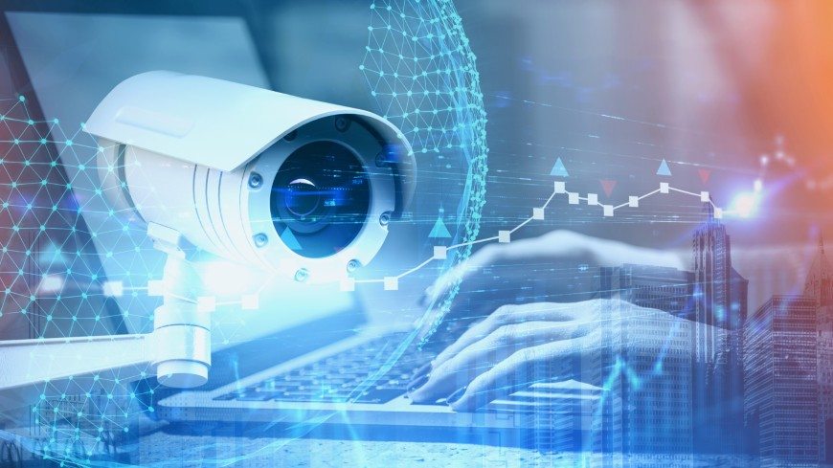
Thank you for your attention

