Slide 1
How the CCCers
Sowed Terror in the 80s
and Are Still Active Today
C
C
ommunist
C
ombattant
ells

Slide 2
Forty years of framing political violence
During the period 1984-1985, the Combatant Communist Cells (CCC) in Belgium committed 29 bomb attacks in Belgium.
Many perceived this bombing campaign at that time as part of a large-scale plot to establish a strong and authoritarian regime.
Was there a “strategy of tension”?
Or how the distance in time can profoundly change the framing of terrorist phenomena.
- 1 -

Slide 3
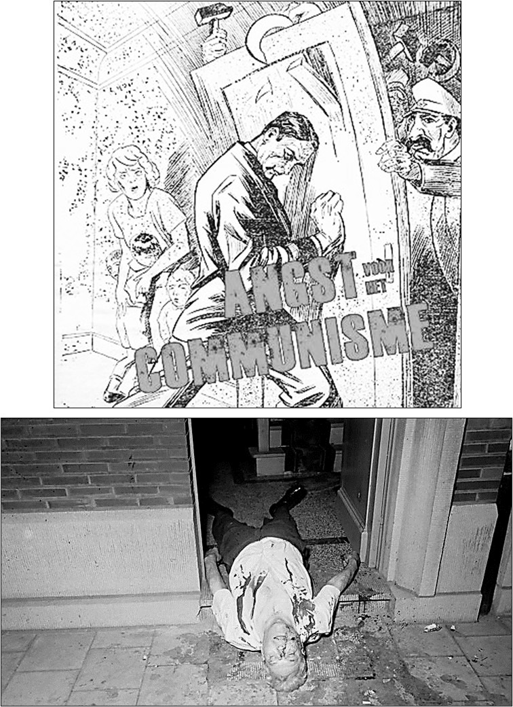
1. Geopolitical context
1984-1985 : It is still Cold War
Strong anti-communist sentiments
Fear for “internal subversion”
The fall of the Berlin Wall is only in 1989
In the slipstream of May 68
In Europe different urban guerilla groups (BR, RAF, AD)
Growing violent assaults (Aldo Moro, H.M. Schleyer, G. Besse
Years of lead in Europe
1990 : The discovery of Gladio & Strategy of Tension in Italy
Increase in violent conflicts between fascist groups and left-wing groups
Assaults disguised as left terrorism
With complicity of fragments of secret services and carabinieri
Aim : People will feel unsafe → Vote for authoritarian parties → turn against communism
GLADIO
- 2 -

Slide 4
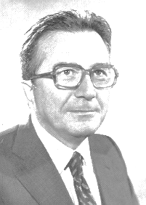
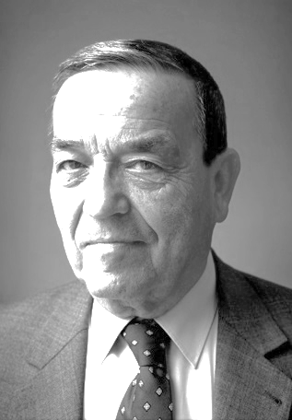
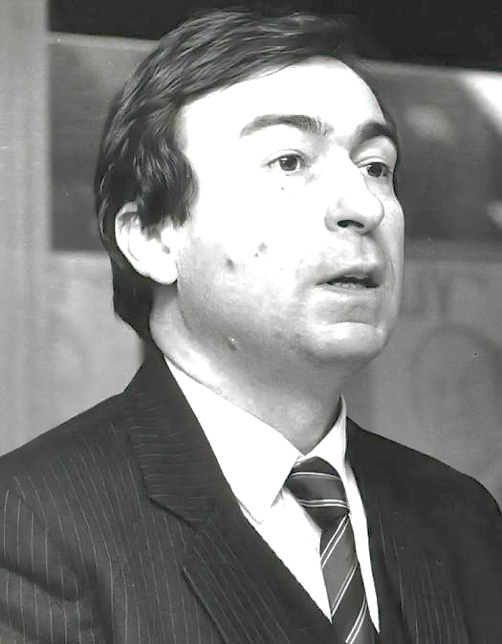
1. Geopolitical context
November 1990 - Prime minister G. Andreotti :
“The last stay behind meeting that took place a few days earlier in Belgium, namely on 23 and 24 October 1990 under the leadership of General Raymond Van Calster".
Call for parliamentary inquiries in different European countries
None of the living Belgian
Prime ministers (6)
Ministers of Defence (6)
Ministers of Justice (5)
had knowledge about the existence of these stay behind networks
Minister of Interior (Belgium): "This is an unhealthy situation. It is unacceptable that a person responsible in such a sensitive dossier assumes the right to decide for himself that his minister is not reliable enough to keep him informed of the work in the service".
- 3 -

Slide 5
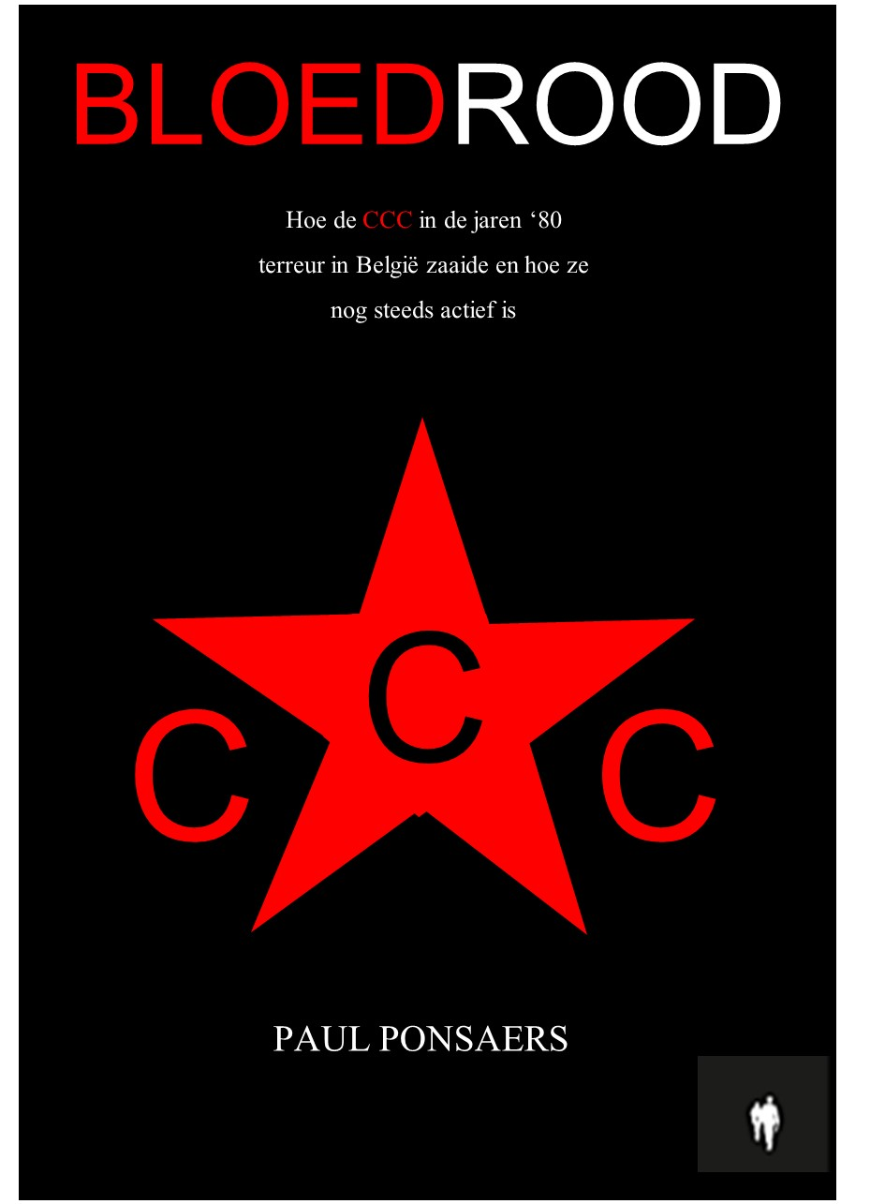
2. Years of lead in Belgium
Bombing attacks
CCC
1984-1985
2025
Facts Brabant Killers
2018
Brabant Killers
1983-1985
- 4 -

Slide 6
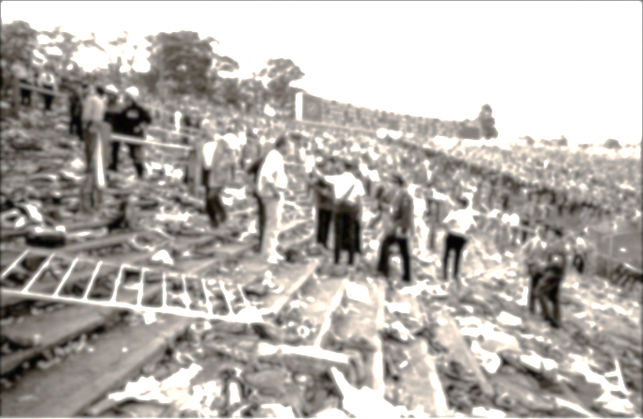
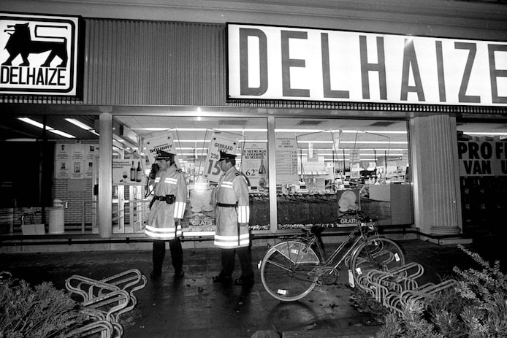
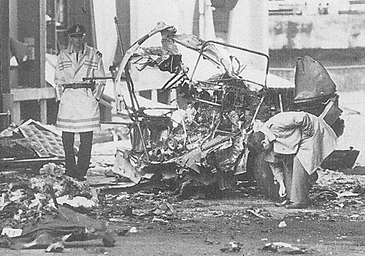
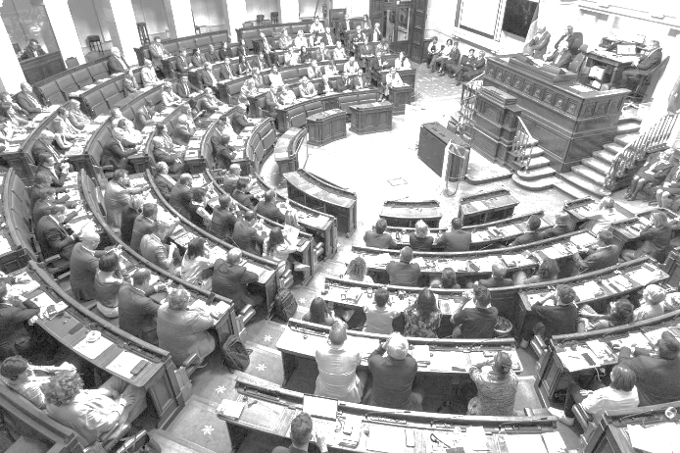
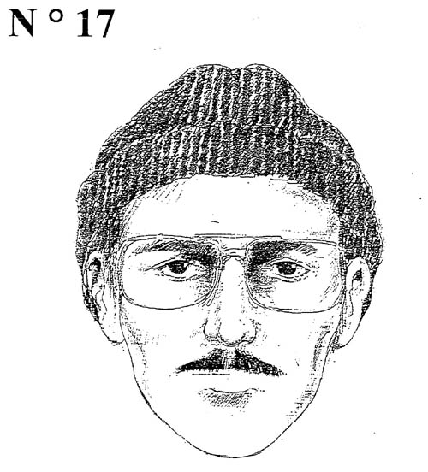
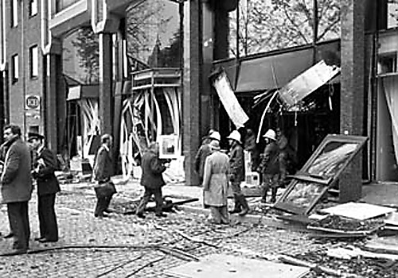
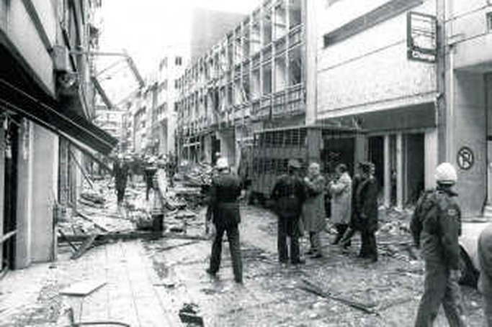
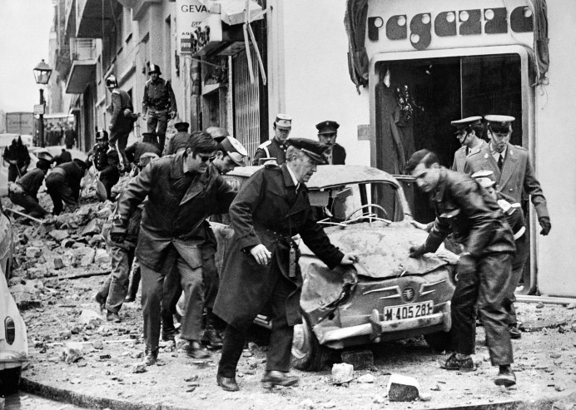
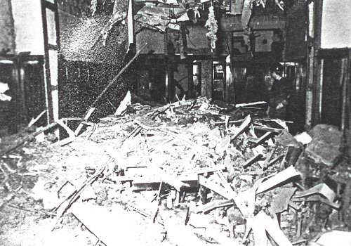
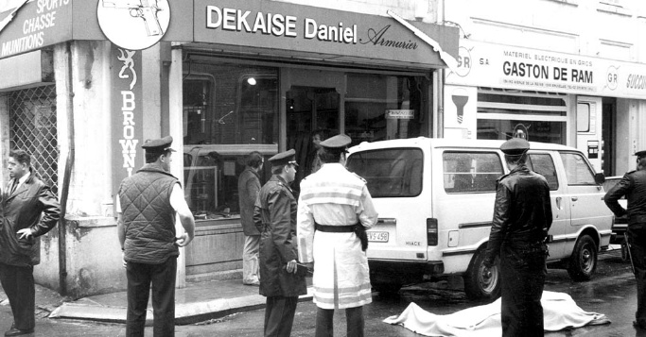
2. Years of lead in Belgium
1983 1st series of attacks Brabant Killers – 12 DEADS
19/05/1984 Attack on the Court House in Brussels - Groupe Inconnu Anarchiste (GIA)
29/06/1984 Attack on a Bank in Elsene - Groupe Inconnu Anarchiste (GIA)
22/06/1985 Attack on Bayer - Peace Conquerors
November 1985 2nd series of attacks Brabant Killers – 16 DEADS
20/08/1986 Attack on the socialist union in Antwerp
28/09/1986 Attack on the Belgian Grand Orient Brussels Lakensestraat
11/11/1986 Attack on the main synagoge in Antwerp
1988 Parliamentary enquiry commission on the Brabant Killers I
1990 Parliamentary enquiry commission on Gladio
1996 Parliamentary enquiry commission on the Brabant Killers II
1980-1981 Parliamentary enquiry on private militia’s
1983 1st series of attacks Brabant Killers – 12 DEADS
19/05/1984 Attack on the Court House in Brussels - Groupe Inconnu Anarchiste (GIA)
29/06/1984 Attack on a Bank in Elsene - Groupe Inconnu Anarchiste (GIA)
05/08/1984 Attack on the Court House in Antwerp ( ETA)
02/10/1984-15/01/1985 Anti-Imperialististic Octobercampaign CCC
20-26/04/1985 Three attacks of Front Révolutionnaire Prolétarien ( FRAP)
01/05/1985 Attack May 1 Union of Belgian Enterpises CCC – 2 DEADS
29/05/1985 Heizel disaster – Parliamentary enquiry commissieon
22/06/1985 Attack on Bayer - Peace Conquerors
08/10/1985-06/12/1985 2nd & 3th campaign CCC
04/11/1985 Assault on money transport Verviers – Gang of Haemers
November 1985 2nd series of attacks Brabant Killers – 16 DEADS
20/08/1986 Attack on the socialist union in Antwerp
28/09/1986 Attack on the Belgian Grand Orient Brussels Lakensestraat
11/11/1986 Attack on the main synagoge in Antwerp
1988 Parliamentary enquiry commission on the Brabant Killers I
1990 Parliamentary enquiry commission on Gladio
1996 Parliamentary enquiry commission on the Brabant Killers II
1980-1981 Parliamentary enquiry on private militia’s
29/05/1985 Heizel disaster – Parliamentary enquiry commissieon
1988 Parliamentary enquiry commission on the Brabant Killers I
1990 Parliamentary enquiry commission on Gladio
1996 Parliamentary enquiry commission on the Brabant Killers II
19/05/1984 Attack on the Court House in Brussels - Groupe Inconnu Anarchiste (GIA)
29/06/1984 Attack on a Bank in Elsene - Groupe Inconnu Anarchiste (GIA)
05/08/1984 Attack on the Court House in Antwerp ( ETA)
20-26/04/1985 Three attacks of Front Révolutionnaire Prolétarien ( FRAP)
22/06/1985 Attack on Bayer - Peace Conquerors
04/11/1985 Assault on money transport Verviers – Gang of Haemers
20/08/1986 Attack on the socialist union in Antwerp
28/09/1986 Attack on the Belgian Grand Orient Brussels Lakensestraat
11/11/1986 Attack on the main synagoge in Antwerp
Conspiracy theories : “Strategy of Tension”?
- 5-

Slide 7
3. The preparation
1975 Establishment of RAF support committee in Brussels by P. Carette
Carette widely distributes press releases and texts from the RAF via Info-RAF
09/05/1976 Dead of Ulrike Meinhof
The disappearance of central positions
“Les extrèmes se touchent”
The brother of Pierre Carette (Jeune Europe – Occident)
Problem of infiltrator Maurice A. (Pour)
Marc DL > Actionsgemeinschaft Nationaler Sozialisten (ANS)
- 6 -

Slide 8
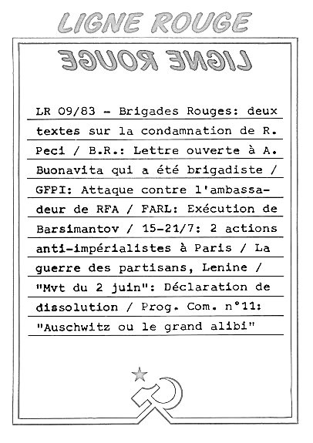
3. The preparation
1981 | Mass protest against the placement of nuclear missiles Foundation of the non-profit organisation Ateliers Graphiques, St-Gillis Documentation Communiste (DOCOM)
10/02/1982 | Foundation of “Subversion” - Carette and Oriach Arrest of Oriach
1983 | Carette goes underground
03/1984 | Criminalization of the antimissiles movement (Gardiner)
13/05/1984 | Weapons theft from the Ardennes Hunters barracks in Vielsalm Operation Oesling 84 – Gladio?
02/06/1984 | Explosives theft from the Ecaussines quarry
Summer ‘83-Autumn '86 | Foundation of the Ligne Rouge “Marriage de raison” with AD
- 7 -

Slide 9
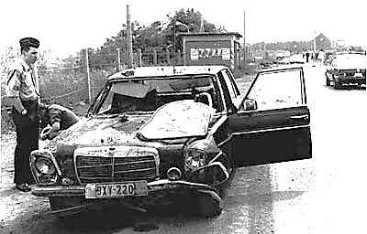
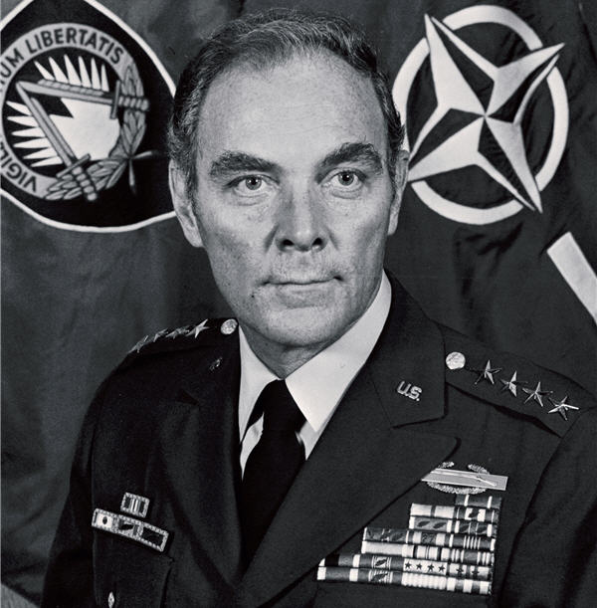
3. The preparation
Is this internal terrorism?
25 june 1979 Attack on A. Haig (NATO)
“Commando Julien Lahaut”
1990 “Commando Andreas Baader” (RAF)
Hidden in the GDR
- 8 -

Slide 10
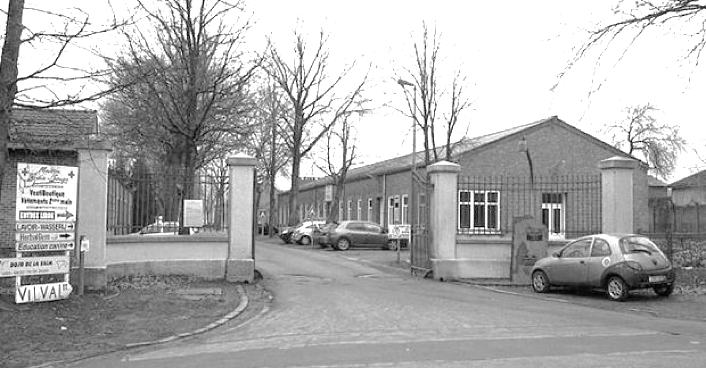
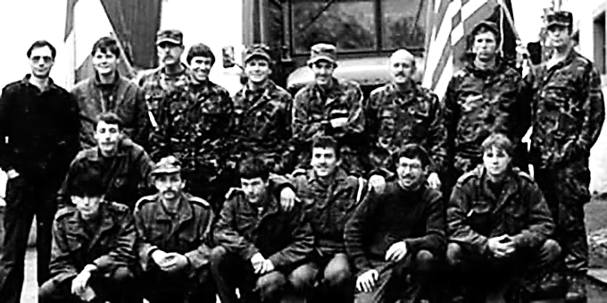
3. The preparation
Is this a gladio operation?
Luxembourg weekly Le Jeudi of 28 October 2013
Photo showing, among others, Belgian soldiers of Operation Oesling '84. Below it says: “The programme from 24 April to 15 May 1984 included infiltration, exfiltration, intelligence activities, initiation to combat techniques and sabotage methods of the special forces” - p. 105.
- 9 -

Slide 11
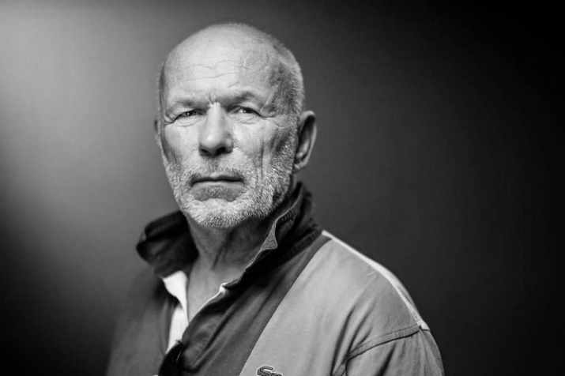
3. The preparation
“And on May 12th around midnight we drove in two cars with all the headlights off down a dirt road. Three of us went in to check the rooms one by one. In the third one a conscript was sleeping. He was robbed on the spot. 'Are you Americans?' he asked. A comrade immediately answered 'No, we are Russians.' He did not seem surprised at all and answered with a very calm - Ah good”.
21/02/1987: Arrest of AD leaders in Vitry-aux-Loges: weapons from Vielsalm.
12/1987: Weapons found near Louviers (Normandy) from the barracks in Vielsalm.
10 April 1997: Five FAL assault rifles in a garage in Uccle
The prehistory of B. Sassoye
The testimony of J-M. Rouillan
Weapons are found in safe-houses of of RAF, AD en CCC
- 10 -

Slide 12
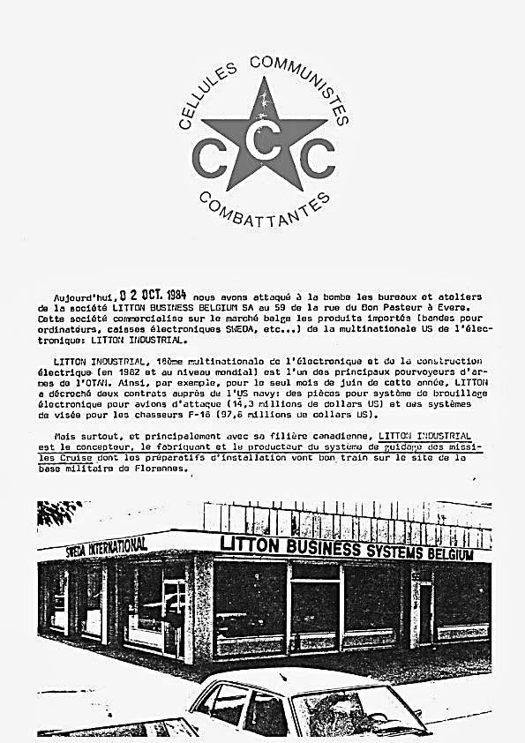
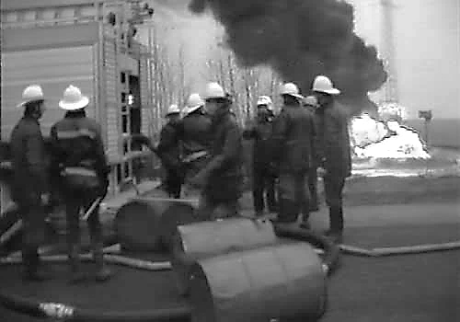
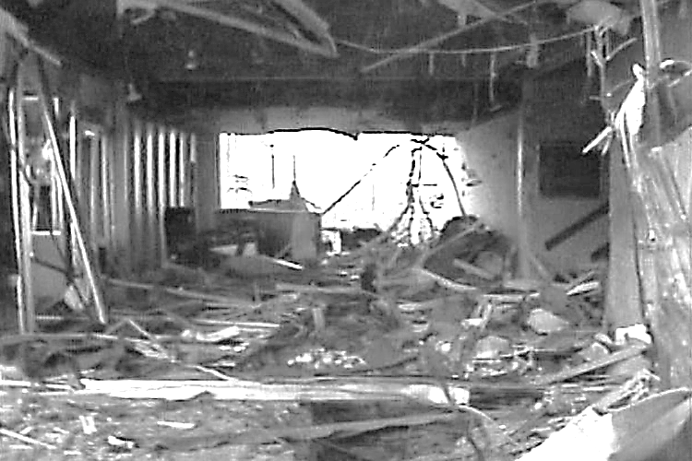
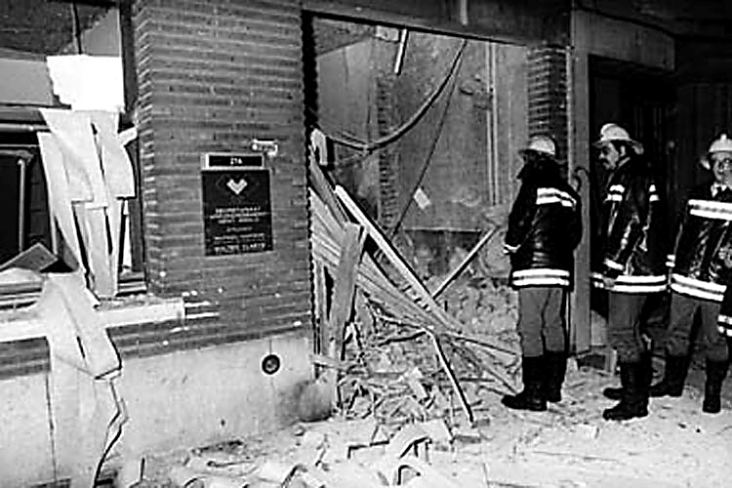
4. The first campaign
02/10/1984 - American electronics company Litton Business
03/10/1984 - West German truck factory Man Truck and Bus
Establishment of “Anti-terrorist Joint Group” (AGG)
08/10/1984 - Honeywell Europe
Government must decide on placement of missiles
15/10/1984 - Researchinstitutes political parties
19/10/1984 “Operation Mammoet”
26/11/1984 - Telecommunication masts near the airport of Bierset
12/12/1984 - NATO pipeline network - “Central Europe Pipe Line System” 15/01/1985 - “Supreme Headquarters of Allied Powers in Europe” (Shape)
01/05/1985 - Attack Union fo Belgian Enterprises Stuiversstraat – 2 DODEN
Five simultaneous attacks on NATO-pipelines
How do you do that with two people?
- 11-

Slide 13
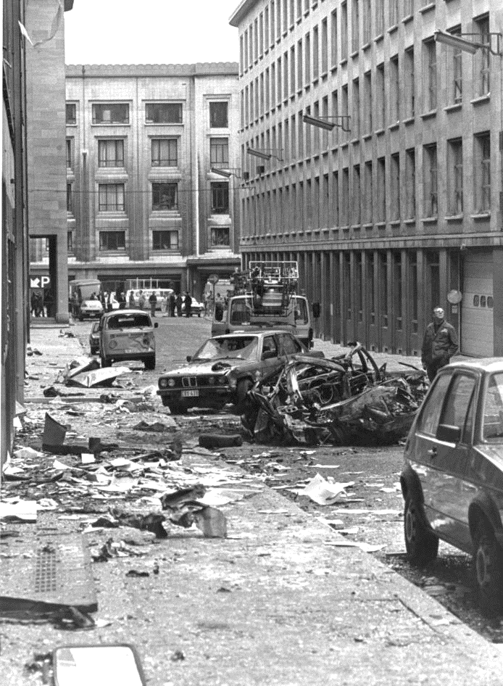
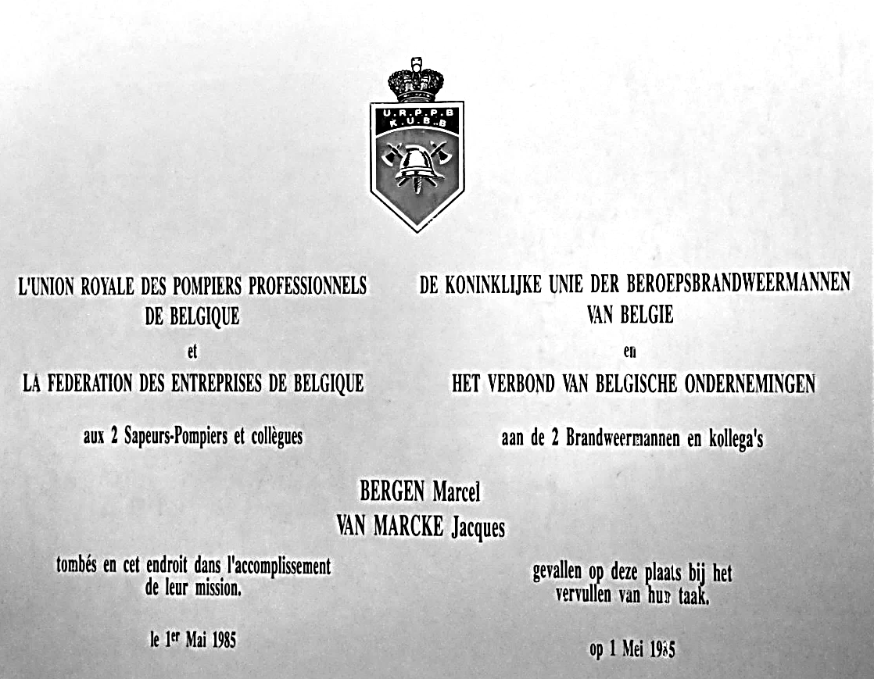
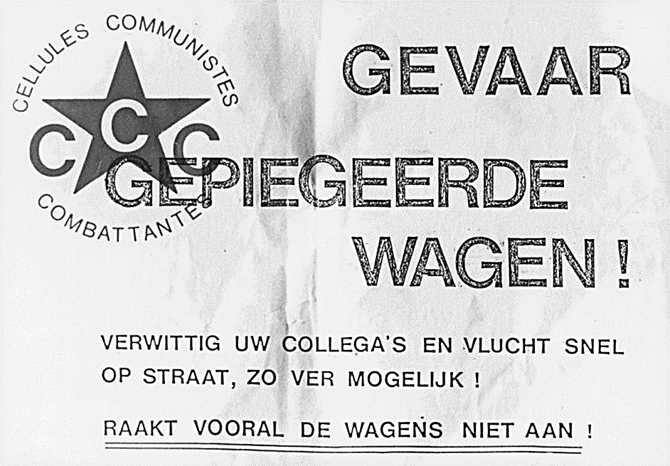
MAY 1st, 1985
4. The first campaign
MAY 6st, 1985
Federation of Belgian Enterprises, Brussels
Attack on the gendarmerie, Brussels
Misunderstanding gendarmerie <> police
Two firefighters died in the incident
The 2 first and only deaths
Radio Silence
- 12 -

Slide 14
5. Front Révolutionnaire d’Action Prolétarienne
01/1985 Declaration of fusion between AD-RAF
CCC rejects the fusion
16/03/1985 First 16 missiles in Florennes
27/03/1985 Letter to the communist party PVDA
20/04/1985 - NAVO-assemblee in the centre of Brussels
21/04/1985 - German enterprise AEG-Telefunken
26/06/1985 - Firm ACEC
15/08/1985 Arrest Chantal Paternostre
Arrest Luc Van Acker
Safe-houses are found, tracks of AD
“A provocation by Action Directe”
- 13 -

Slide 15
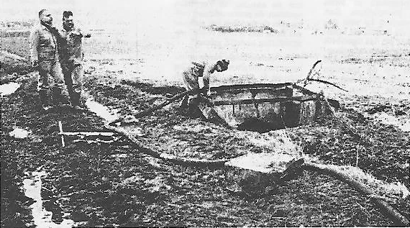
6. The second campaign
Xx/10/1985 Chevolet and Vandegeerde go underground
08/10/1985 Attack gas and electricity company Sibelgaz
12/10/1985 Attack Fabrimetal & Taxservice
18/10/1985 Attack Infosermi (Army)
20/10/1985 Firebomb thrown at Pierre Galand, president of the CNAPD
4-5/11/1985 Attack on 4 banks (BBL, Generale, Hannover Trust Bank, KB)
> Fingerprint
21/11/1985 Attack on Motorola
04/12/1985 Attack on Bank of America
06/12/1985 Attack on NATO-pipelines
- 14 -

Slide 16
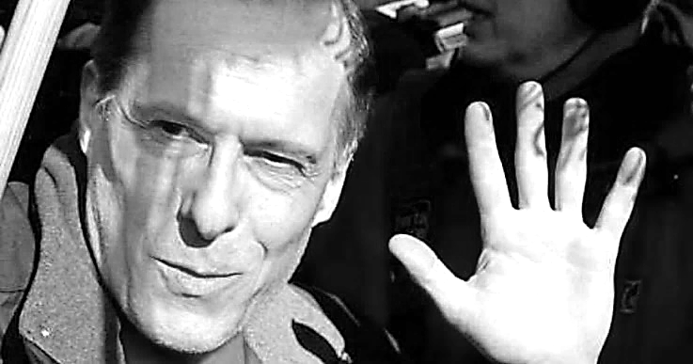
7. The outcome
16/12/1985 Arrest of 4 members of CCC
Infrastructure is discovered
Foundation “Association of Parents and Friends
of Communist Prisoners”
Hungerstrikes
26/09/1988 Start process
21/10/1988 Lifetime for all CCC-members
FRAP-members get 5 years
09/11/1989 Fall of the Berlin Wall
10/04/1992 Farewell to arms of the RAF
2000-2003 Early release
2004
Today
- 15 -

Slide 17
8. Conclusion
1. Were the arrests long in coming?
Compared to the Brabant Killers
The name of P. Carette circulated in the media for a year as a witness
But: - no idea where he was hiding
- no material evidence for a long period
“We can't arrest someone just because he has the face of a criminal”
2. Can four people have done this?
It was about “armed propaganda for the proletarian revolution” > no success
CCC did not create a “school” (<> RAF, AD, BR)
No sympathy from the peace movement
Only intertwined with other urban guerrilla-groups
- 16 -

Slide 18
8. Conclusion
3. Part of a large-scale conspiracy?
In any case not in terms of a Gladio-scheme
In other words: - No disguised right-wing group
- No complicity of state-apparatuses
- Yes, in terms of Stasi and East-Germany
They were: - Yes, they were “useful idiots”
- Criminalization of the peace movement
4. Polarization is a two-way street
The fascination with extreme positions
Every end has a new beginning
- 17 -

Slide 19
C
C
C

